Slide 1
Microsoft Visual C#: An Introduction to Object-Oriented Programming
7th Edition
Chapter 2
Using Data
© 2018 Cengage. All Rights Reserved. May not be copied, scanned, or duplicated, in whole or in part, except for use as permitted in a license distributed with a certain product or service or otherwise on a password-protected website for classroom use.

Slide 2
Objectives (1 of 2)
2.1 Declare variables
2.2 Display variable values
2.3 Use integral data types
2.4 Use floating-point data types
2.5 Use arithmetic operators
© 2018 Cengage. May not be copied, scanned, or duplicated, in whole or in part, except for use as permitted in a license distributed with a certain product or service or otherwise on a password-protected website for classroom use.

Slide 3
Objectives (2 of 2)
2.6 Use the bool data type
2.7 Describe numeric type conversion
2.8 Use the char data type
2.9 Use the string data type
2.10 Define named constants and enumerations
2.11 Accept console input
© 2018 Cengage. May not be copied, scanned, or duplicated, in whole or in part, except for use as permitted in a license distributed with a certain product or service or otherwise on a password-protected website for classroom use.

Slide 4
Declaring Variables (1 of 5)
Constant
Cannot be changed after a program is compiled
Literal constant
Its value is taken literally at each use
Variable
A named location in computer memory that can hold different values at different points in time
Data type
Describes the format and size of (amount of memory occupied by) a data item
© 2018 Cengage. May not be copied, scanned, or duplicated, in whole or in part, except for use as permitted in a license distributed with a certain product or service or otherwise on a password-protected website for classroom use.

Slide 5
Declaring Variables (2 of 5)
Intrinsic Types (list appears on next slide)
Built-in Date Types
Alias names for a class in the System namespace
All of the built-in types except object and string are called simple types
Most commonly used built-in data types:
int, double, decimal, char, string, and bool
Unicode is the system that provides a numeric value for every character.
© 2018 Cengage. May not be copied, scanned, or duplicated, in whole or in part, except for use as permitted in a license distributed with a certain product or service or otherwise on a password-protected website for classroom use.

Slide 6
Declaring Variables (3 of 5)
Variable declaration
A statement that names a variable and reserves storage
Example: int myAge = 25;
A declaration includes the following:
The data type that the variable will store
The variable’s name (its identifier)
An optional assignment operator and assigned value when you want a variable to contain an initial value
An ending semicolon
© 2018 Cengage. May not be copied, scanned, or duplicated, in whole or in part, except for use as permitted in a license distributed with a certain product or service or otherwise on a password-protected website for classroom use.

Slide 7
Declaring Variables (4 of 5)
The equal sign (=) is the assignment operator
Any value to the right of the assignment operator is assigned to the identifier to the left
An assignment made when a variable is declared is an initialization
An assignment made later is simply an assignment
The following statement initializes myAge to 25:
int myAge = 25;
A statement such as the following assigns a new value to the variable:
myAge = 42;
Notice the data type is not used again when an assignment is made
It is only used in a declaration
© 2018 Cengage. May not be copied, scanned, or duplicated, in whole or in part, except for use as permitted in a license distributed with a certain product or service or otherwise on a password-protected website for classroom use.

Slide 8
Declaring Variables (5 of 5)
You can declare a variable without an initialization value:
int myAge;
You can make an assignment to an uninitialized variable later in the program
But you cannot use the variable in a calculation or display it until a value has been assigned to it
Some programmers prefer to break declarations across multiple lines:
Int myAge = 25, yourAge = 19;
When a statement occupies more than one line
It is easier to read if lines after the first one are indented a few spaces
© 2018 Cengage. May not be copied, scanned, or duplicated, in whole or in part, except for use as permitted in a license distributed with a certain product or service or otherwise on a password-protected website for classroom use.

Slide 9
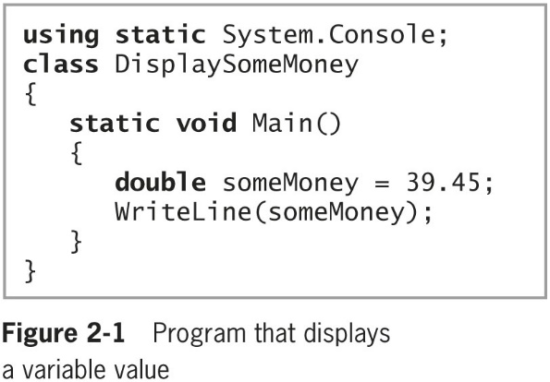
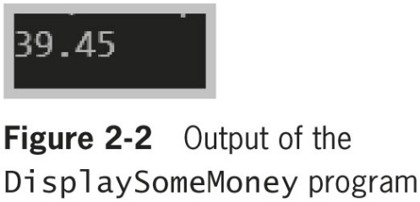
Displaying Variable Values (1 of 6)
You can display variable values by using the variable name within a Write() or WriteLine() method call
© 2018 Cengage. May not be copied, scanned, or duplicated, in whole or in part, except for use as permitted in a license distributed with a certain product or service or otherwise on a password-protected website for classroom use.

Slide 10
Displaying Variable Values (2 of 6)
The program in Figure 2-3 adds some explanation to the output
The program uses the Write() method to display the string “The money is $” before displaying the value of someMoney
When you concatenate a string with another value, you join the values with a plus sign
WriteLine(“The money is $” + someMoney);
© 2018 Cengage. May not be copied, scanned, or duplicated, in whole or in part, except for use as permitted in a license distributed with a certain product or service or otherwise on a password-protected website for classroom use.

Slide 11
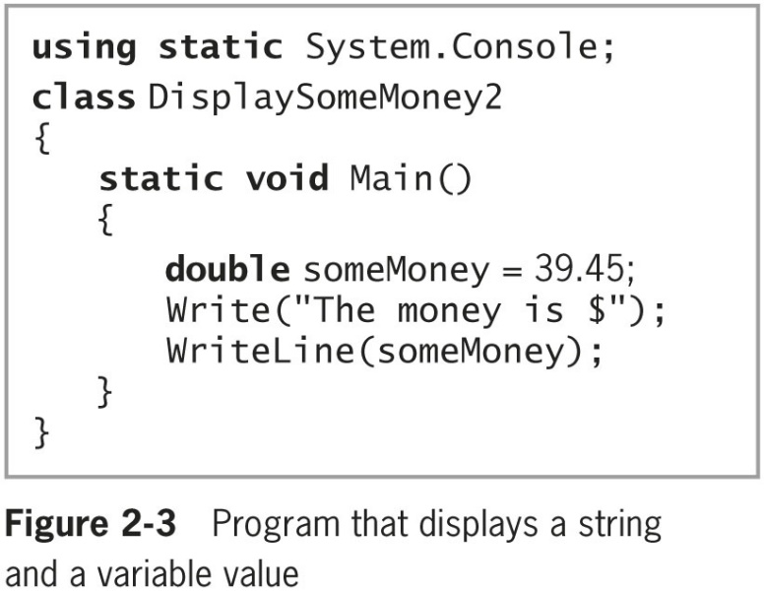
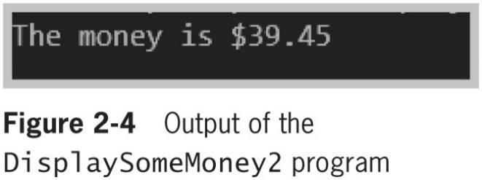
Displaying Variable Values (3 of 6)
© 2018 Cengage. May not be copied, scanned, or duplicated, in whole or in part, except for use as permitted in a license distributed with a certain product or service or otherwise on a password-protected website for classroom use.

Slide 12
Displaying Variable Values (4 of 6)
Format string
A string of characters that optionally contains fixed text
Contains one or more format items or placeholders for variable values
Placeholder
Consists of a pair of curly braces containing a number that indicates the desired variable’s position in a list that follows the string
The first position is always position 0
String interpolation
The process of replacing string place holders with values
© 2018 Cengage. May not be copied, scanned, or duplicated, in whole or in part, except for use as permitted in a license distributed with a certain product or service or otherwise on a password-protected website for classroom use.

Slide 13
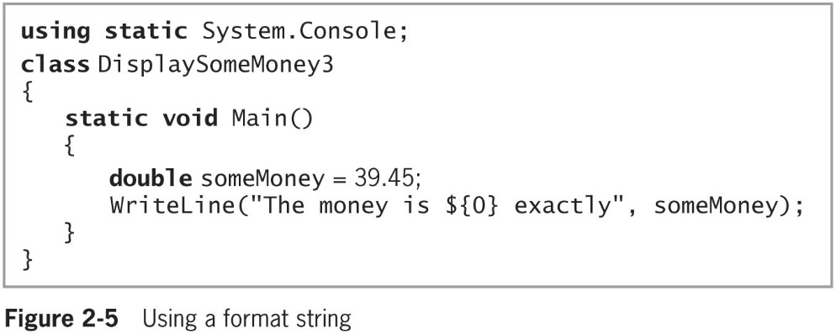
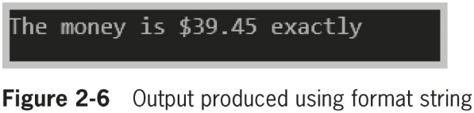
Displaying Variable Values (5 of 6)
© 2018 Cengage. May not be copied, scanned, or duplicated, in whole or in part, except for use as permitted in a license distributed with a certain product or service or otherwise on a password-protected website for classroom use.

Slide 14
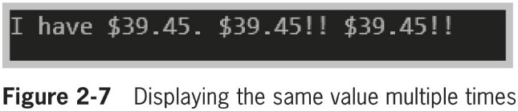
Displaying Variable Values (6 of 6)
© 2018 Cengage. May not be copied, scanned, or duplicated, in whole or in part, except for use as permitted in a license distributed with a certain product or service or otherwise on a password-protected website for classroom use.

Slide 15
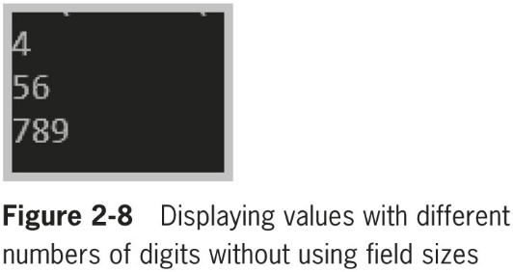
Variable Alignment (1 of 3)
The following code produces the unaligned output shown in Figure 2-8:
WriteLine("{0}", 4);
WriteLine("{0}", 56);
WriteLine("{0}", 789);
© 2018 Cengage. May not be copied, scanned, or duplicated, in whole or in part, except for use as permitted in a license distributed with a certain product or service or otherwise on a password-protected website for classroom use.

Slide 16
Variable Alignment (2 of 3)
The following code produces the unaligned output shown in Figure 2-9:
WriteLine("{0, 5}", 4);
WriteLine("{0, 5}", 56);
WriteLine("{0, 5}", 789);
WriteLine("{0, -8}{1, -8}", "Richard", "Lee");
WriteLine("{0, -8}{1, -8}", "Marcia", "Parker");
WriteLine("{0, -8}{1, -8}", "Ed", "Tompkins");
© 2018 Cengage. May not be copied, scanned, or duplicated, in whole or in part, except for use as permitted in a license distributed with a certain product or service or otherwise on a password-protected website for classroom use.

Slide 17
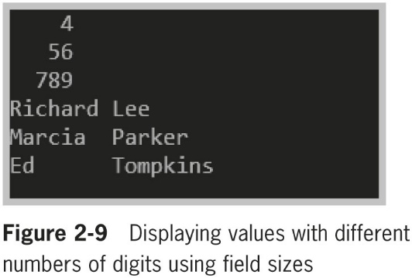
Variable Alignment (3 of 3)
© 2018 Cengage. May not be copied, scanned, or duplicated, in whole or in part, except for use as permitted in a license distributed with a certain product or service or otherwise on a password-protected website for classroom use.

Slide 18
Using the Integral Data Types (1 of 2)
Integral data types
Types that store whole numbers
byte, sbyte, short, ushort, int, uint, long, ulong, and char
Variables of type int
Store (or hold) integers, or whole numbers
Shorter integer types
byte, sbyte (which stands for signed byte), short (short int), or ushort (unsigned short int)
© 2018 Cengage. May not be copied, scanned, or duplicated, in whole or in part, except for use as permitted in a license distributed with a certain product or service or otherwise on a password-protected website for classroom use.

Slide 19
Using the Integral Data Types (2 of 2)
When you assign a value to any numeric variable
You do not use any commas or other nonnumeric characters such as dollar or percent signs
The exception, starting with C# 7.0, you can insert underscores as digit separators for readability
Example:
int aLotOfMoney = 23456789;
int aLotOfMoney = 23_456_789;
© 2018 Cengage. May not be copied, scanned, or duplicated, in whole or in part, except for use as permitted in a license distributed with a certain product or service or otherwise on a password-protected website for classroom use.

Slide 20
Using Floating-Point Data Types (1 of 2)
Floating-point number
Contains decimal positions
A value’s number of significant digits specifies the mathematical accuracy of the value
Floating-point data types
float
Can hold up to 7 significant digits of accuracy
double
Can hold 15 or 16 significant digits of accuracy
decimal
Can hold 28 or 29 significant digits but a smaller range
Suitable for financial and monetary calculations
© 2018 Cengage. May not be copied, scanned, or duplicated, in whole or in part, except for use as permitted in a license distributed with a certain product or service or otherwise on a password-protected website for classroom use.

Slide 21
Using Floating-Point Data Types (2 of 2)
Float
can hold as many as seven significant digits of accuracy
Put an F after a number to make it a float
Double
can hold 15 or 16 significant digits of accuracy
Put a D after it to make it a double (default)
Decimal
Put an M after it to make it a decimal
Scientific notation
Includes an E (for exponent)
© 2018 Cengage. May not be copied, scanned, or duplicated, in whole or in part, except for use as permitted in a license distributed with a certain product or service or otherwise on a password-protected website for classroom use.

Slide 22
Formatting Floating-Point Values (1 of 3)
C# displays floating-point numbers in the most concise way it can while maintaining the correct value
Standard numeric format strings
Strings of characters expressed within double quotation marks that indicate a format for output
Take the form X0
X is the format specifier; 0 is the precision specifier
Format specifiers
Define the most commonly used numeric format types
Precision specifiers
Control the number of significant digits or zeros to the right of the decimal point
© 2018 Cengage. May not be copied, scanned, or duplicated, in whole or in part, except for use as permitted in a license distributed with a certain product or service or otherwise on a password-protected website for classroom use.

Slide 23
Formatting Floating-Point Values (2 of 3)
Example: the first WriteLine() statement in the following code produces 123.00 and the second produces 123.000
double someMoney = 123;
string moneyString;
moneyString = someMoney.ToString("F");
WriteLine(moneyString);
moneyString = someMoney.ToString("F3");
WriteLine(moneyString);
© 2018 Cengage. May not be copied, scanned, or duplicated, in whole or in part, except for use as permitted in a license distributed with a certain product or service or otherwise on a password-protected website for classroom use.

Slide 24
Formatting Floating-Point Values (3 of 3)
Example: the following WriteLine() statement produces $456,789.00:
double moneyValue = 456789;
string conversion;
conversion = moneyValue.ToString("C");
WriteLine(conversion);
© 2018 Cengage. May not be copied, scanned, or duplicated, in whole or in part, except for use as permitted in a license distributed with a certain product or service or otherwise on a password-protected website for classroom use.

Slide 25
Using Arithmetic Operators
Arithmetic operators
Addition, subtraction, multiplication, division, and remainder
Binary operators
Use two values (operands)
Operator precedence
Rules that determine the order in which parts of a mathematical expression are evaluated
Multiplication, division, and remainder (modulus) always take place prior to addition or subtraction in an expression
You can override normal operator precedence with parentheses
Expressions are evaluated left to right
© 2018 Cengage. May not be copied, scanned, or duplicated, in whole or in part, except for use as permitted in a license distributed with a certain product or service or otherwise on a password-protected website for classroom use.

Slide 26
Using Shortcut Arithmetic Operators (1 of 2)
Add and assign operator
Example: bankBal += bankBal * interestRate;
Variations: −=, *=, /=, and %=
To increase a variable’s value by exactly 1, you can use either the prefix increment operator or the postfix increment operator
Prefix increment operator
Example: ++someValue;
Postfix increment operator
Example: someValue++;
© 2018 Cengage. May not be copied, scanned, or duplicated, in whole or in part, except for use as permitted in a license distributed with a certain product or service or otherwise on a password-protected website for classroom use.

Slide 27
Using Shortcut Arithmetic Operators (2 of 2)
Unary operator
Uses only one value (e.g., −123)
Prefix and postfix increment operators are unary operators
Decrement operator (--)
Can be prefix or postfix
Reduces a variable’s value by 1
© 2018 Cengage. May not be copied, scanned, or duplicated, in whole or in part, except for use as permitted in a license distributed with a certain product or service or otherwise on a password-protected website for classroom use.

Slide 28
Using the bool Data Type
Boolean variable
Can hold only one of two values—true or false
Declare a Boolean variable with data type bool
Comparison operator
Compares two items
An expression containing a comparison operator returns a Boolean value
Comparison operators are:
Less than (<)
Greater than (>)
Equal to (==)
Less than or equal to (<=)
Greater than or equal to (>=)
Not equal to (!=)
© 2018 Cengage. May not be copied, scanned, or duplicated, in whole or in part, except for use as permitted in a license distributed with a certain product or service or otherwise on a password-protected website for classroom use.

Slide 29
Understanding Numeric Type Conversion (1 of 3)
Arithmetic with variables or constants of the same type
Result retains the same type
Arithmetic with operands of dissimilar types
C# chooses a unifying type for the result
Implicitly (or automatically) converts nonconforming operands to the unifying type
Which is the type with the higher type precedence
Called an implicit conversion or an implicit cast—the automatic transformation that occurs when a value is assigned to a type with higher precedence.
© 2018 Cengage. May not be copied, scanned, or duplicated, in whole or in part, except for use as permitted in a license distributed with a certain product or service or otherwise on a password-protected website for classroom use.

Slide 30
Understanding Numeric Type Conversion (2 of 3)
Implicit cast
Automatic transformation that occurs when a value is assigned to a type with higher precedence
Implicit numeric conversions are:
From sbyte to short, int, long, float, double, or decimal
From byte to short, ushort, int, uint, long, ulong, float, double, or decimal
From short to int, long, float, double, or decimal
From ushort to int, uint, long, ulong, float, double, or decimal
From int to long, float, double, or decimal
From uint to long, ulong, float, double, or decimal
From long to float, double, or decimal
From ulong to float, double, or decimal
From char to ushort, int, uint, long, ulong, float, double, or decimal
From float to double
© 2018 Cengage. May not be copied, scanned, or duplicated, in whole or in part, except for use as permitted in a license distributed with a certain product or service or otherwise on a password-protected website for classroom use.

Slide 31
Understanding Numeric Type Conversion (3 of 3)
Explicit cast
Placing the desired result type in parentheses followed by the variable or constant to be cast
Two explicit casts are performed in the following code:
double bankBalance = 191.66;
float weeklyBudget = (float) bankBalance / 4;
// weeklyBudget is 47.915, one-fourth of bankBalance
int dollars = (int) weeklyBudget;
// dollars is 47, the integer part of weeklyBudget
© 2018 Cengage. May not be copied, scanned, or duplicated, in whole or in part, except for use as permitted in a license distributed with a certain product or service or otherwise on a password-protected website for classroom use.

Slide 32
Using the char Data Type (1 of 2)
char data type
Holds any single character
Place constant character values within single quotation marks (e.g., ‘D')
char aCharValue = ‘9’ cannot be used in arithmetic statements – the 9 is text, not a number
Escape sequence
Stores a pair of characters
Begins with a backslash
A pair of symbols represents a single character
Example:
char aBackspaceChar = '\b'
char aTabChar = '\t';
© 2018 Cengage. May not be copied, scanned, or duplicated, in whole or in part, except for use as permitted in a license distributed with a certain product or service or otherwise on a password-protected website for classroom use.

Slide 33
Using the char Data Type (2 of 2)
Characters used in C# are represented in Unicode, which is a 16-bit coding scheme for characters
For example, the letter A actually is stored in computer memory as a set of 16 zeros and ones—namely, 0000 0000 0100 0001
16-bit numbers are difficult to read so programmers often use a shorthand notation called hexadecimal, or base 16. In hexadecimal shorthand, 0000 becomes 0
0100 becomes 4, and 0001 becomes 1. Thus, the letter A is represented in hexadecimal as 0041
Two ways to store the character A:
char letter = 'A';
char letter = '\u0041';
© 2018 Cengage. May not be copied, scanned, or duplicated, in whole or in part, except for use as permitted in a license distributed with a certain product or service or otherwise on a password-protected website for classroom use.

Slide 34
Using the string Data Type (1 of 5)
string data type
Holds a series of characters
Values are expressed within double quotation marks
Example: string firstName = "Jane";
Comparing strings
Use == and !=
Use the Equals() method, Compare() method, and CompareTo() method
A string is considered equal to, greater than, or less than another string lexically, which in the case of letter values means alphabetically
© 2018 Cengage. May not be copied, scanned, or duplicated, in whole or in part, except for use as permitted in a license distributed with a certain product or service or otherwise on a password-protected website for classroom use.

Slide 35
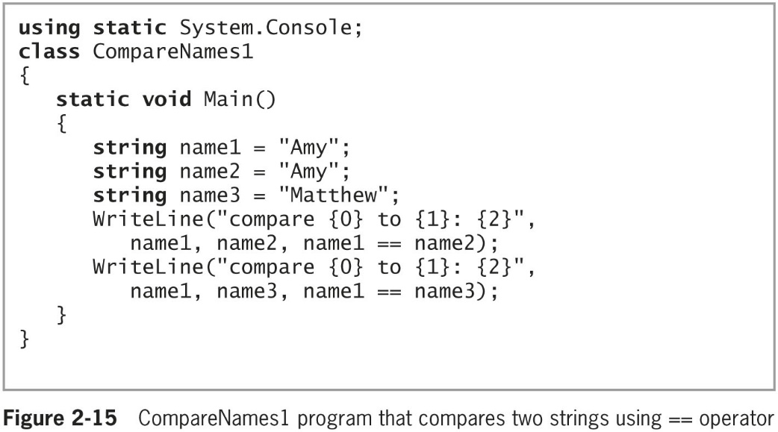
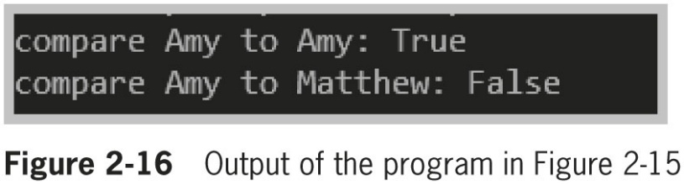
Using the string Data Type (2 of 5)
© 2018 Cengage. May not be copied, scanned, or duplicated, in whole or in part, except for use as permitted in a license distributed with a certain product or service or otherwise on a password-protected website for classroom use.

Slide 36
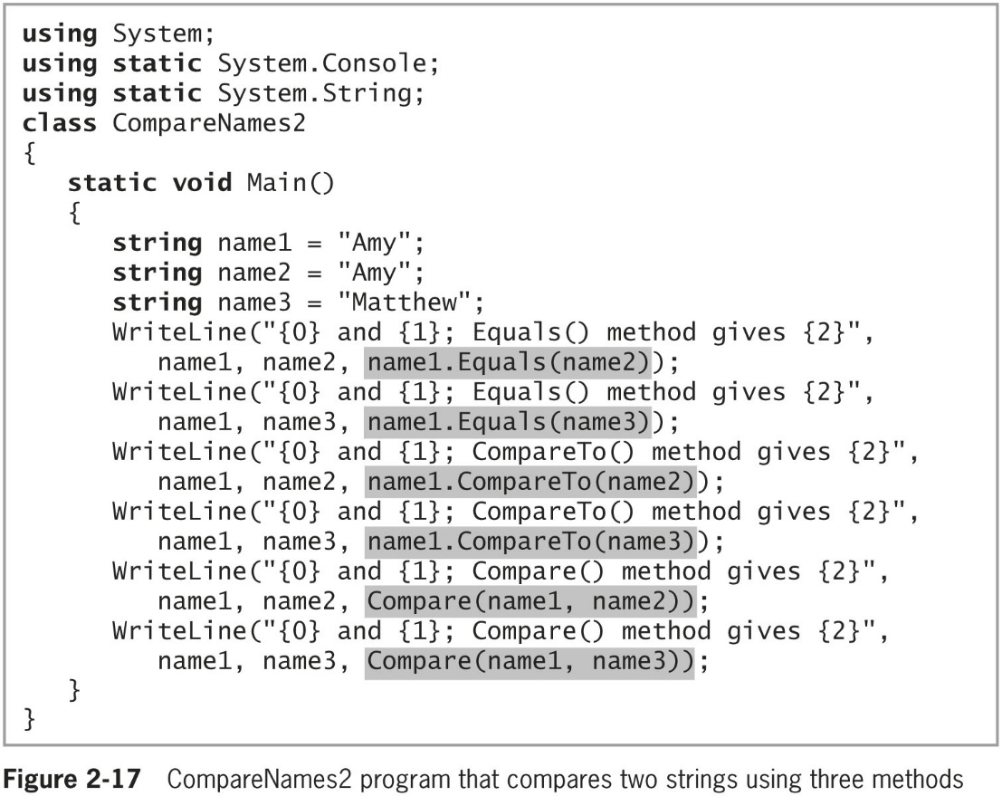
Using the string Data Type (3 of 5)
© 2018 Cengage. May not be copied, scanned, or duplicated, in whole or in part, except for use as permitted in a license distributed with a certain product or service or otherwise on a password-protected website for classroom use.

Slide 37
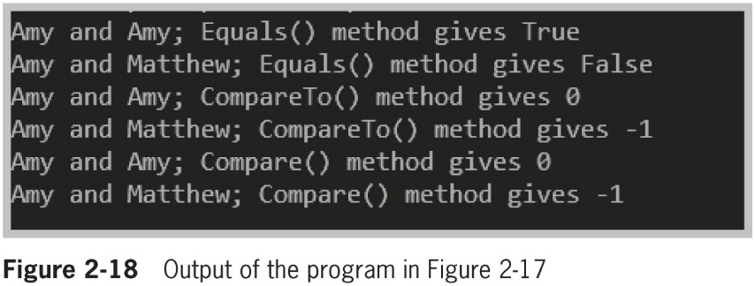
Using the string Data Type (4 of 5)
© 2018 Cengage. May not be copied, scanned, or duplicated, in whole or in part, except for use as permitted in a license distributed with a certain product or service or otherwise on a password-protected website for classroom use.

Slide 38
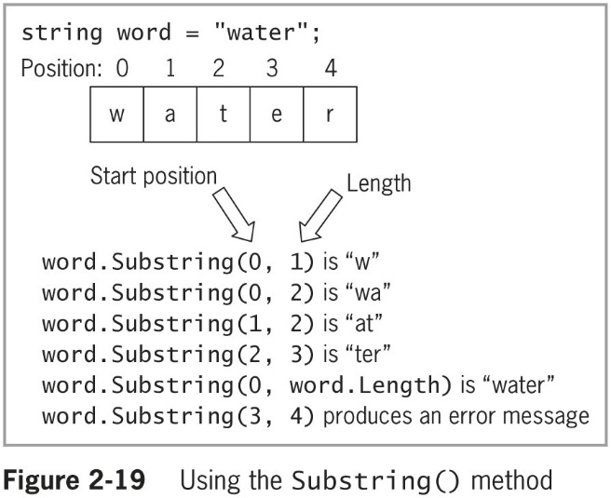
Using the string Data Type (5 of 5)
Use the Substring() method to extract a portion of a string from a starting point for a specific length
© 2018 Cengage. May not be copied, scanned, or duplicated, in whole or in part, except for use as permitted in a license distributed with a certain product or service or otherwise on a password-protected website for classroom use.

Slide 39
Defining Named Constants
Named constant
Often simply called a constant
An identifier whose contents cannot change
Created using the keyword const
Programmers sometimes name constants using all uppercase letters, inserting underscores for readability
Other programmers object to this style and call it screaming caps
Self-documenting statement
Easy to understand even without program comments
© 2018 Cengage. May not be copied, scanned, or duplicated, in whole or in part, except for use as permitted in a license distributed with a certain product or service or otherwise on a password-protected website for classroom use.

Slide 40
Working with Enumerations (1 of 2)
An enumeration is a set of constants represented by identifiers
Enumeration example named DayOfWeek:
enum DayOfWeek
{
SUNDAY, MONDAY, TUESDAY, WEDNESDAY,
THURSDAY, FRIDAY, SATURDAY
}
By default, enumeration values are integer
Can specify otherwise by including a colon and a type name after the enumeration name
© 2018 Cengage. May not be copied, scanned, or duplicated, in whole or in part, except for use as permitted in a license distributed with a certain product or service or otherwise on a password-protected website for classroom use.

Slide 41
Working with Enumerations (2 of 2)
Creating an enumeration type provides you with several advantages:
If you did not create an enumerated type, you could use another type
If you did not create an enumerated type, you could create another type to represent days, but invalid behavior could be applied to the values
Programmers say using enums makes the values type-safe. Type-safe describes a data type for which only appropriate behaviors are allowed
The enum constants provide a form of self-documentation
© 2018 Cengage. May not be copied, scanned, or duplicated, in whole or in part, except for use as permitted in a license distributed with a certain product or service or otherwise on a password-protected website for classroom use.

Slide 42
Accepting Console Input
Interactive program
A program that allows user input
ReadLine() method
Accepts all of the characters entered by a user input from the keyboard until the user presses Enter
Characters can be assigned to a string
Must use a conversion method to convert the input string to the proper type
© 2018 Cengage. May not be copied, scanned, or duplicated, in whole or in part, except for use as permitted in a license distributed with a certain product or service or otherwise on a password-protected website for classroom use.

Slide 43
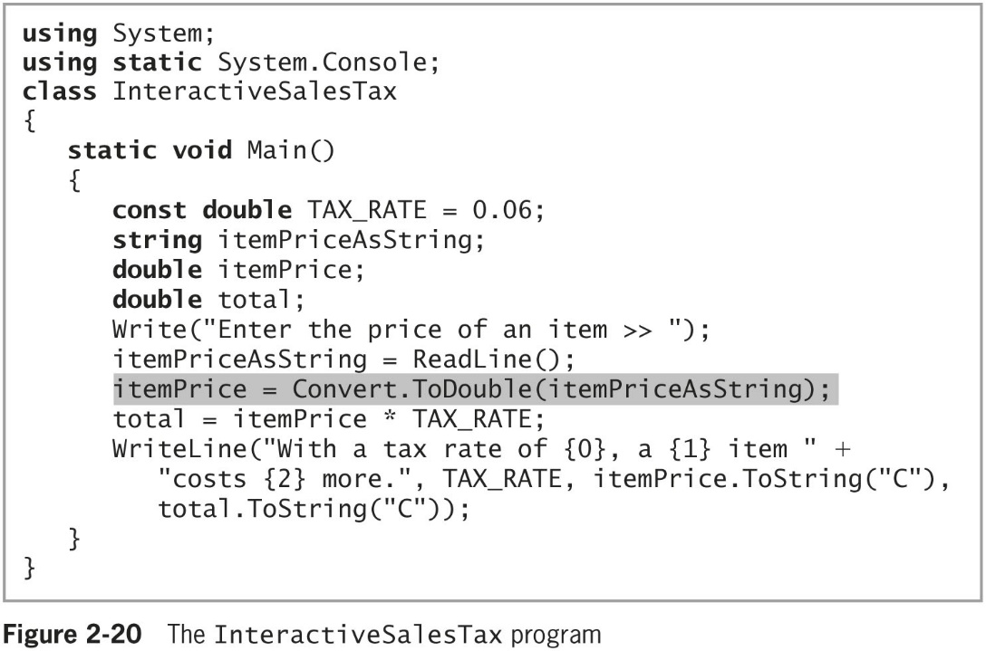
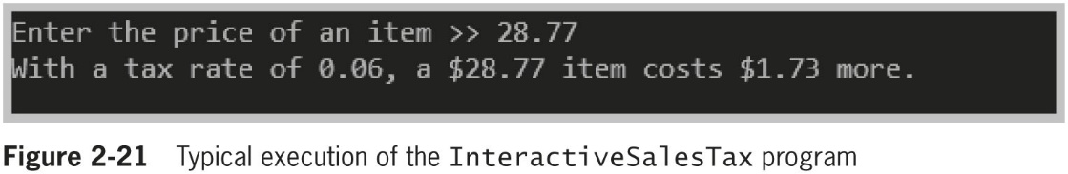
Using the Convert Class
Figure 2-20 shows an interactive program that prompts the user for a price and calculates a 6 percent sales tax
© 2018 Cengage. May not be copied, scanned, or duplicated, in whole or in part, except for use as permitted in a license distributed with a certain product or service or otherwise on a password-protected website for classroom use.

Slide 44
Using the Parse() Methods
Parse() method
An alternative to the Convert class methods to convert a string to a number
Parse means to break into component parts
Parsing a string turns it into its numeric equivalent
© 2018 Cengage. May not be copied, scanned, or duplicated, in whole or in part, except for use as permitted in a license distributed with a certain product or service or otherwise on a password-protected website for classroom use.

Slide 45
Chapter Summary (1 of 2)
A constant is a data value that cannot be changed after compilation
Display variable values with Write() or WriteLine()
Nine integral data types: byte, sbyte, short, ushort, int, uint, long, ulong, and char
Three floating-point data types: float, double, and decimal
Use the binary arithmetic operators +, –, *, /, and % to manipulate values in your programs
© 2018 Cengage. May not be copied, scanned, or duplicated, in whole or in part, except for use as permitted in a license distributed with a certain product or service or otherwise on a password-protected website for classroom use.

Slide 46
Chapter Summary (2 of 2)
A bool variable can be true or false
Implicit cast versus explicit cast
The char data type holds any single character
The string data type holds a series of characters
Named constants are program identifiers whose values cannot change
The ReadLine() method accepts user input
© 2018 Cengage. May not be copied, scanned, or duplicated, in whole or in part, except for use as permitted in a license distributed with a certain product or service or otherwise on a password-protected website for classroom use.

